Slide 1
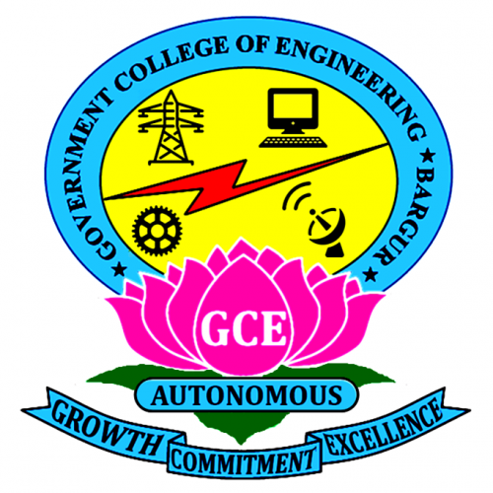
GOVERNMENT COLLEGE OF ENGINEERING BARGUR (AUTONOMOUS)
Project Presentation
“THIRAN - TAMIL PROGRAMMING LANGUAGE”
Department of Computer Science and Engineering

Slide 2
PROJECT TEAM:
REG NO. | NAME
1911109 | BALAPATHY. V
1911147 | SURYA NARAYANAN. S
2011906 | SARAVANAN. K
Under the guidance of
Dr. J. Nafeesa Begum, M.E., Ph.D.,
Professor & Head,
Department of Computer Science And Engineering.

Slide 3
ABSTRACT:
This project aims to develop a simple and easy-to-learn programming language called “Thiran” (திறன்) that allows coding in Tamil. This programming language will help school students to develop their problem-solving skills by making code more readable and understandable. It will familiarize them with the concepts and fundamentals of programming before moving on to real-world programming languages. Furthermore, this project will contribute to the growth of the technology industry in Tamil-speaking regions, leading to more diverse and inclusive programming solutions.

Slide 4
WHY A TAMIL PROGRAMMING LANGUAGE ?
In nearly every widely used programming language, the names of symbols and keywords (e.g., for, while, if, else) are borrowed from English.
Education research suggests that learning in one’s local language can have a positive impact on the outcomes of learning.
Accordingly, we had the motivation to develop a Tamil Programming Language to cater to the educational needs of native Tamil-speaking K-12 students.

Slide 5

About Thiran:
திறன் நிரலாக்க மொழி
Thiran Programming Language
Paradigm: Interpreted, Imperative, Structured, Procedural
License: GNU GPLv3 (Open-source & Freely available)
Aim: Educational, Bridging the language barrier in CS
Focuses on: Simplicity, Easy-to-learn syntax
Inspired by: Python & Ezhil

Slide 6
Any Tamil Programming Languages that exists?
Ezhil (எழில்) is an open-source, interpreted, procedural Tamil script based programming language.
It was the first freely available programming language in the Tamil language.
It was designed by Muthiah Annamalai.
The best thing about Ezhil is that its syntax allows statements to be closer to the Subject-Object-Verb structure (SOV), of the Tamil language.

Slide 7
Thiran vs Ezhil:
The main differences between Thiran and Ezhil are:
Thiran focuses on simplicity over preserving Tamil sentence structure (SOV). | Ezhil focuses on preserving Tamil sentence structure (SOV).
Though implemented in Python, Thiran is self-contained and doesn’t support any Python functions or elements. | Ezhil is tightly integrated into Python runtime and has full access to the Python programming language environment.

Slide 8
Ezhil vs Thiran - Syntactical Difference:
THIRAN SYNTAX | EZHIL SYNTAX
சரியெனில் (2 > 3): # true branch தவறெனில்: # false branch முடி | @ (2 > 3) ஆனால் # true branch இல்லை # false branch முடி
உண்மைவரை (க < 5): # code to loop முடி | @ (க < 5) வரை # code to loop முடி
காட்டு ("வணக்கம்!") | பதிப்பி "வணக்கம்!"

Slide 9
Programming with Thiran:
Keywords in Thiran:
and - மற்றும்
or - அல்லது
not - இல்லை
true - சரி
false - தவறு
if - சரியெனில்
elif - அல்லதெனில்
else - தவறெனில்
end - முடி
while - உண்மைவரை
for - திரும்பச்செய்
func - செயல்பாகம்
return - வெளிகொடு
break - நிறுத்து
continue - தொடர்
import - இணை
Some built-in functions in Thiran:
print() - காட்டு()
input() - வாங்கு()
int() - முழுஎண்()
float() - புள்ளிஎண்()
string() - வாக்கியம்()
exit() - வெளியேறு()
append_list() - பட்டியல்_இணை()
remove_from_list() - பட்டியல்_நீக்கு()
add_to_list() - பட்டியல்_சேர்()
pop_list() - பட்டியல்_சுருக்கு()
list_len() - பட்டியல்_நீளம்()
type() - வகை()

Slide 10
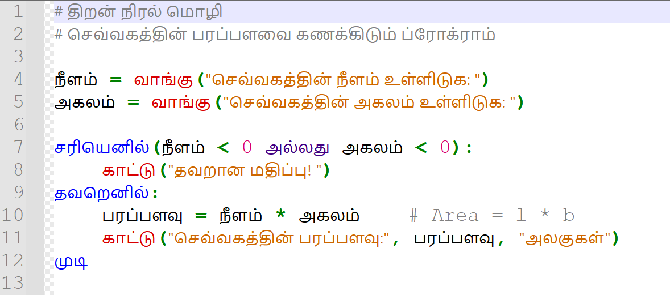
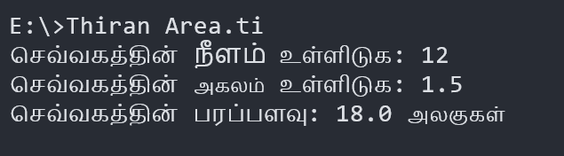
Thiran - Example Program 1:

Slide 11
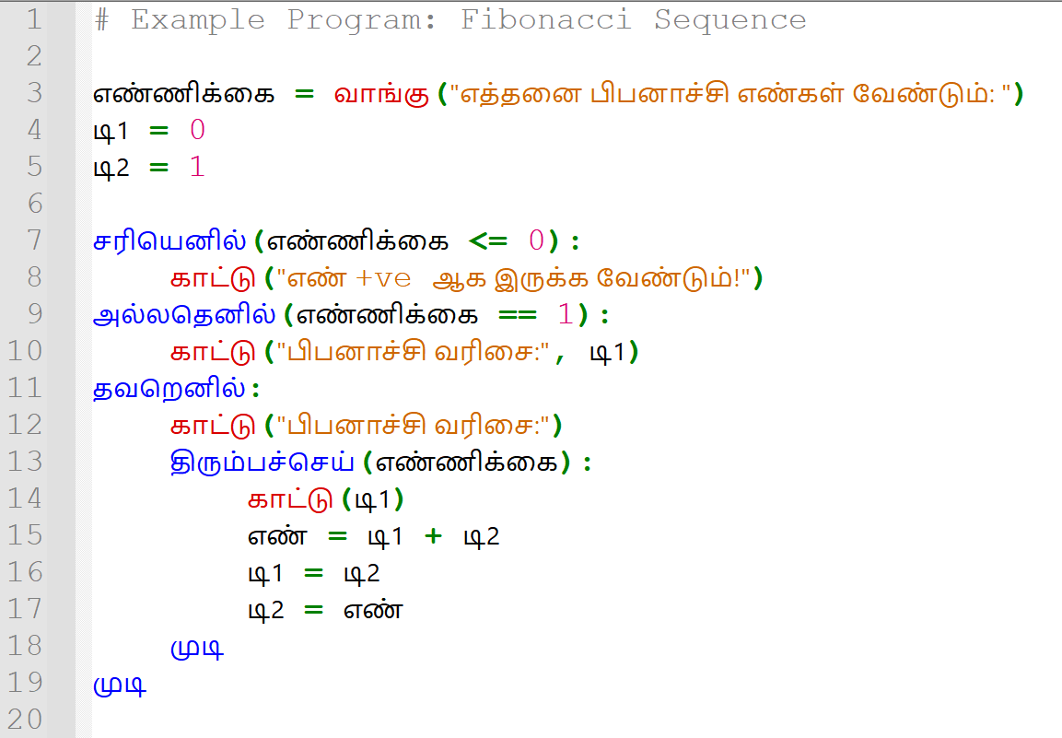
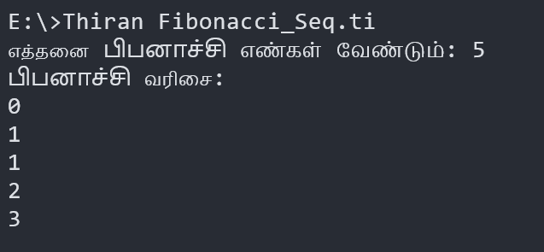
Thiran - Example Program 2:

Slide 12
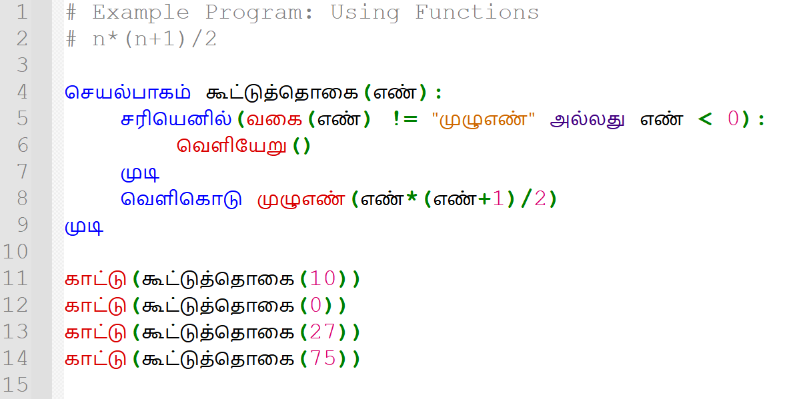
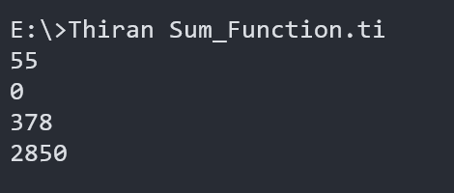
Thiran - Example Program 3:

Slide 13
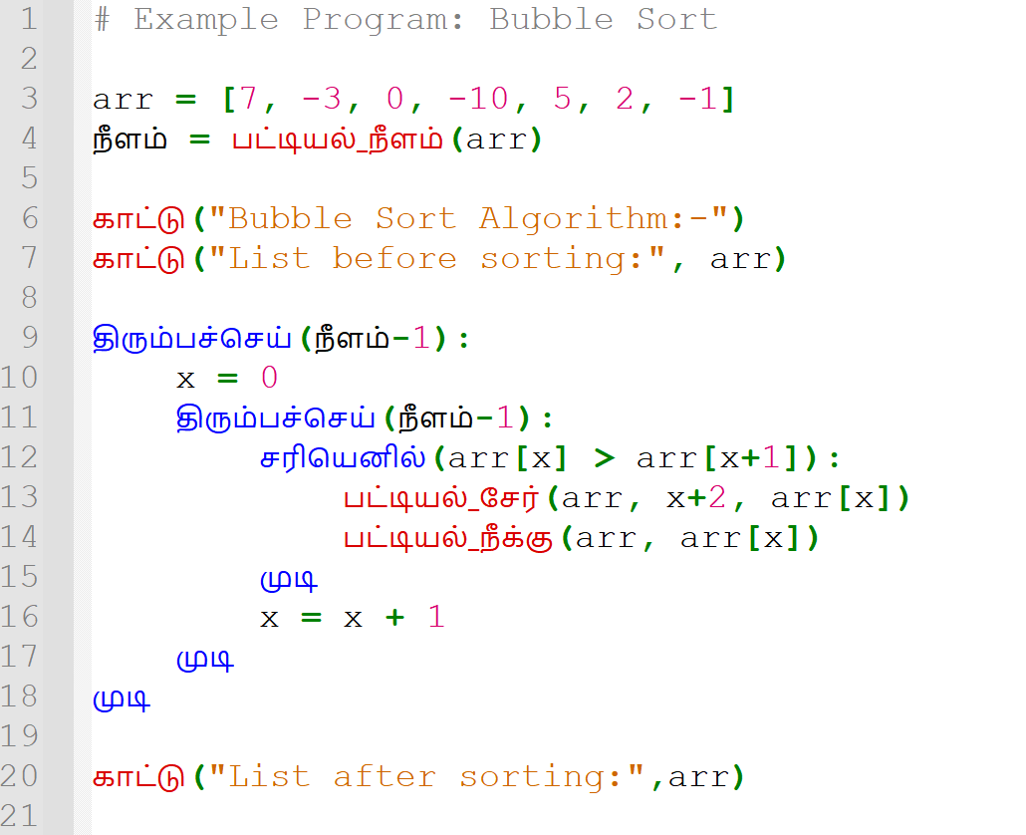
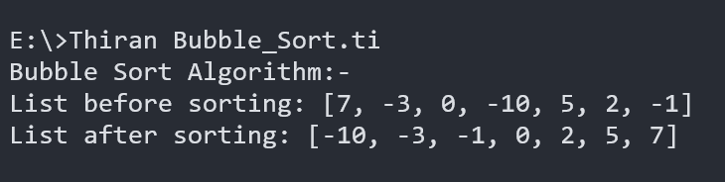
Thiran - Example Program 4:

Slide 14
FUTURE WORK:
Thiran, as a programming language, has tremendous scope in vernacular Computer Science education.
With proper support from the Government, Thiran can be taught to middle school Tamil medium students.
Also, the language can be extended further by adding support for the following:
Exception Handling
Bitwise Operators
Switch Statement
Standard libraries
Multi-level indexing support
File Handling support, etc.

Slide 15
REFERENCES:
Aho, Sethi, Ullman, Compilers: Principles, Techniques, and Tools, Addison-Wesley, 1986. ISBN 0-201-10088-6
Dasgupta, Sayamindu, and Benjamin Mako Hill. "Learning to code in localized programming languages." Proceedings of the fourth (2017) ACM conference on learning@ scale. 2017.
Annamalai, Muthiah. "Ezhil: A Tamil Programming Language." arXiv preprint arXiv:0907.4960 (2009).
Raj, Adalbert Gerald Soosai, et al. "What Do Students Feel about Learning Programming Using Both English and Their Native Language?." 2017 International Conference on Learning and Teaching in Computing and Engineering (LaTICE). IEEE, 2017.
National Education Policy, 2020

Slide 16
TO CONCLUDE:
"The fundamental principles that will guide both the education system at large, as well as the individual institutions within it are: [...] promoting multilingualism and the power of language in teaching and learning"
- National Education Policy, 2020

Slide 17
Thank You!
Any questions?

